Slide 1
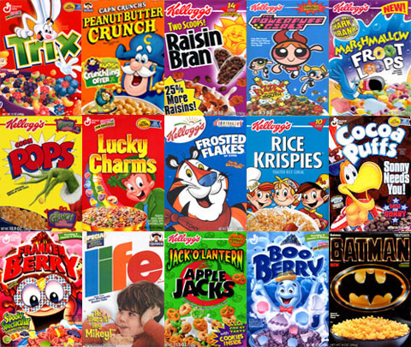
Ku Ku for Cocoa Puffs!
Hands-On Activity
By Amanda Horvers

Slide 2
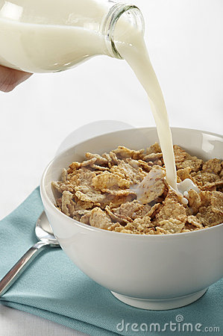
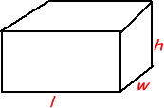
Background Information
For this activity the students will…
Be asked to complete a hands-on activity during the length of one class period. The task will be to bring in his/her favorite cereal (in the box please!). I will ask the students to try and purchase cereal that would be easy to count out by hand. The boxes that I will specify on purchasing are the INDIVIDUAL SIZE boxes, NOT the family size larger boxes of cereal. I will be supplying the larger boxes myself for the students.
Once the cereal boxes are brought in the task will be to count out the number of cereal pieces in the individual size boxes on either a paper plate or paper towel on his/her desk. Then the students will find the volume for that box by using the ruler given and correctly measuring the box. The students’ will do the same for the volume of the larger box of cereal in order to fill out the worksheet. Once this task is complete the students will be asked to create a proportion and find the value of “X” (the estimated number of cereal pieces in the larger box).
6th grade level

Slide 3
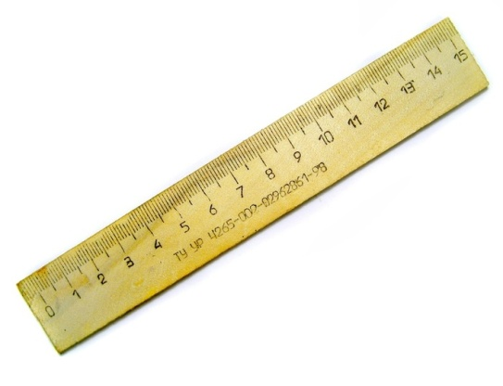
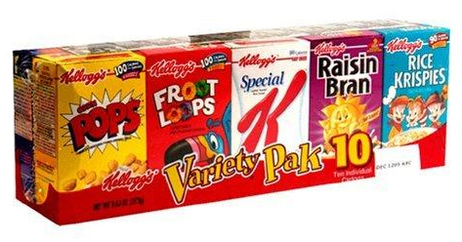
Materials needed…
Worksheet with instructions
Ruler for each student
Paper towel, paper plate, bowls and spoons
Pencils/erasers
Small (individual) cereal boxes and large (family size) cereal boxes

Slide 4
Goals and objectives
1) Students will learn and understand the concept of the terms ratio, proportion, and volume.
2) Students will learn how to find the volume of both boxes of cereal and properly compute and make their own ratios and proportions using the knowledge they already know about the topic.
1) Given the hands-on activity worksheet, the student will complete the activity, “Ku Ku for Cocoa Puffs” with 80% or better accuracy based on a 20 point rubric. (See attachment)
2) Given the proper materials the student will measure and determine the volume (cm^3) of each of his/her cereal boxes to create a proportion set up with 100% accuracy.
3) Given the three vocabulary terms from this hands-on activity, the student will be able to define each term with 100% accuracy.

Slide 5
vocabulary
Ratio - is just a comparison between two different things.
A:B
Proportion- a part considered in relation to the whole. The relationship between things or parts of things with respect to quantity.
A/B=X/C “find X”
Volume - is the amount of space that a three dimensional object can occupy.
Volume of a rectangle- V= (L*W*H)^3

Slide 6
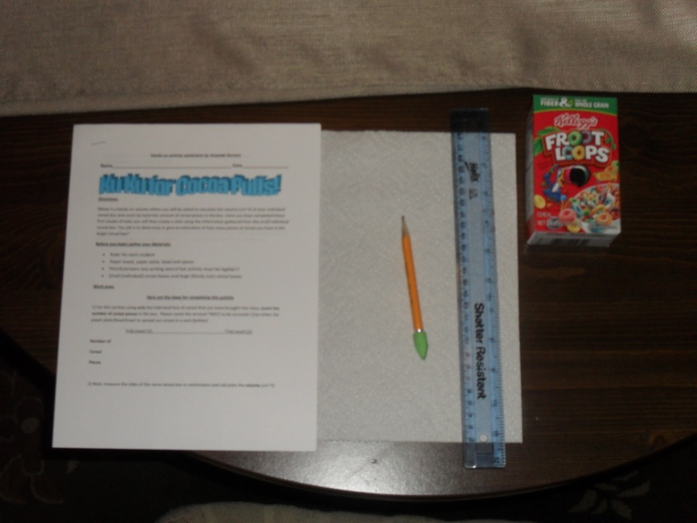
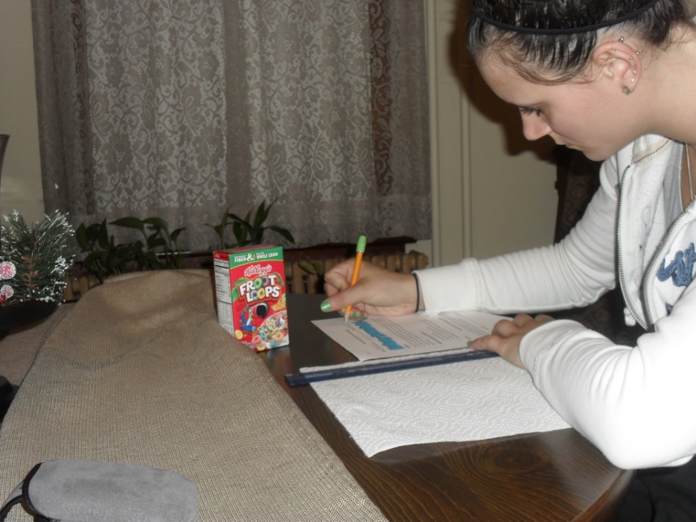
1.Step by step…
Gather all materials need for this activity. See worksheet.

Slide 7
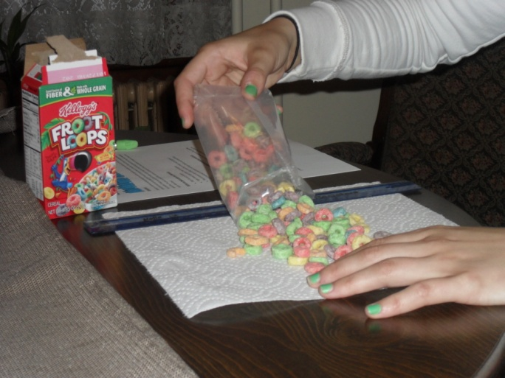
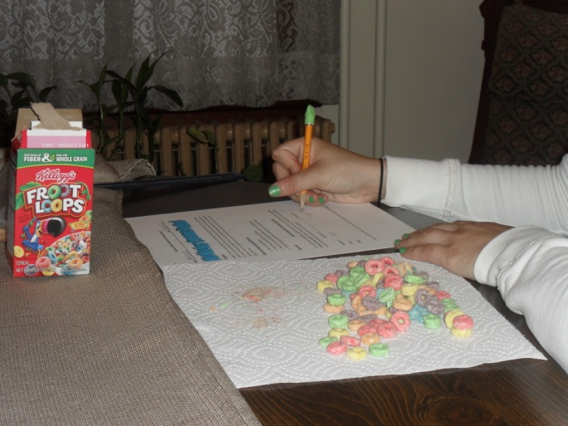
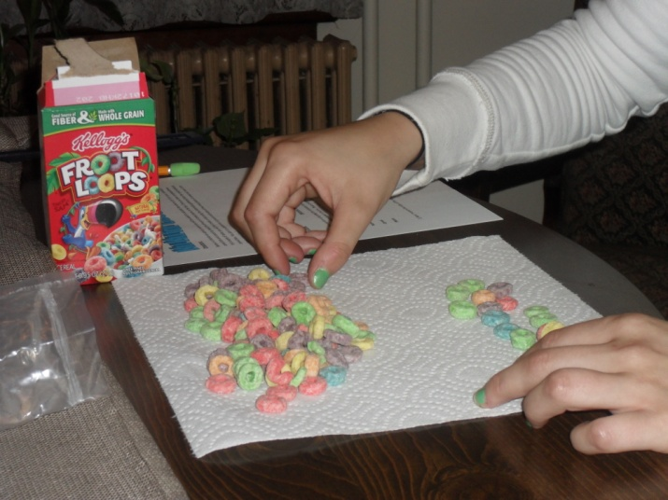
2.Step by step…
Carefully open your small box of cereal and pour it on a paper plate or towel. In two trials count the number of cereal pieces and place the numbers found in the chart given.

Slide 8
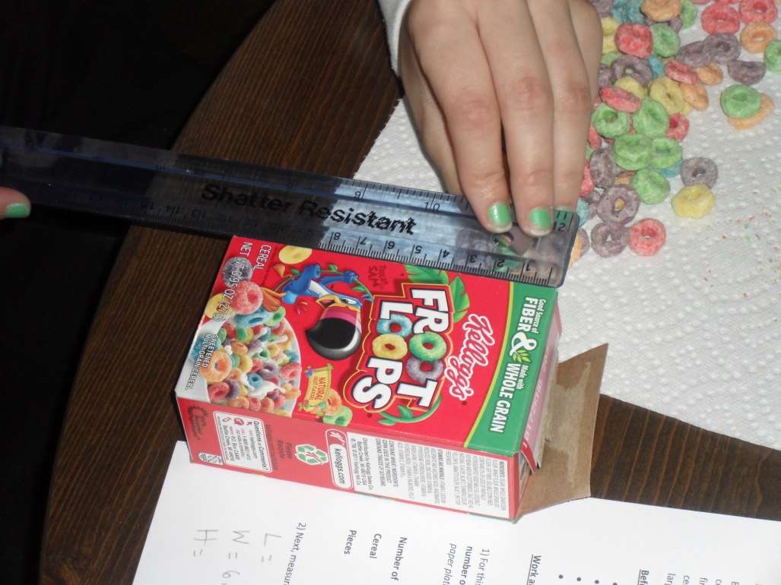
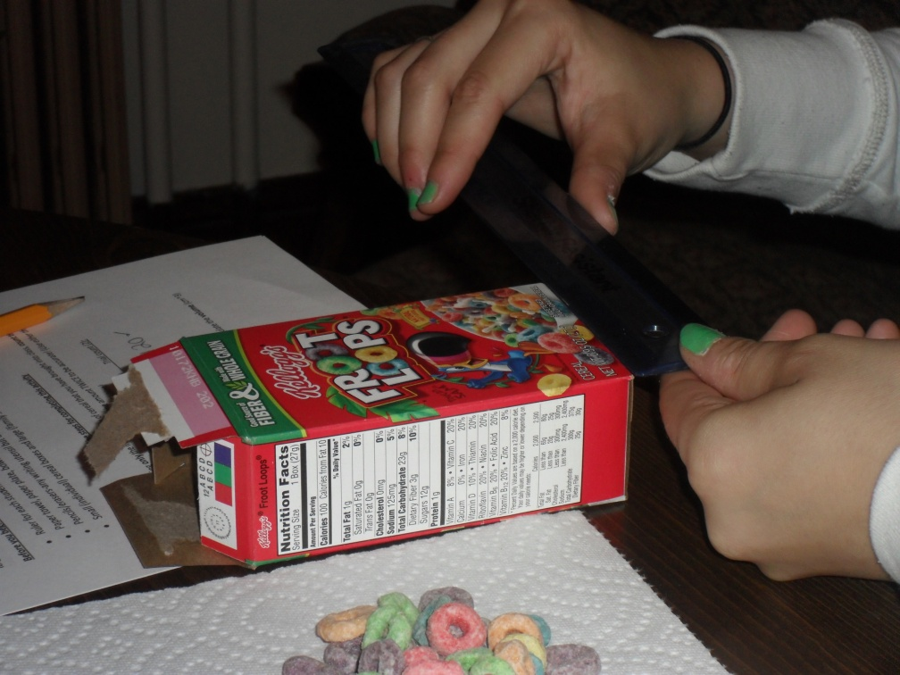
3.Step by step…
The next step is to measure the sides and calculate the volume of the small individual box. (cm)

Slide 9
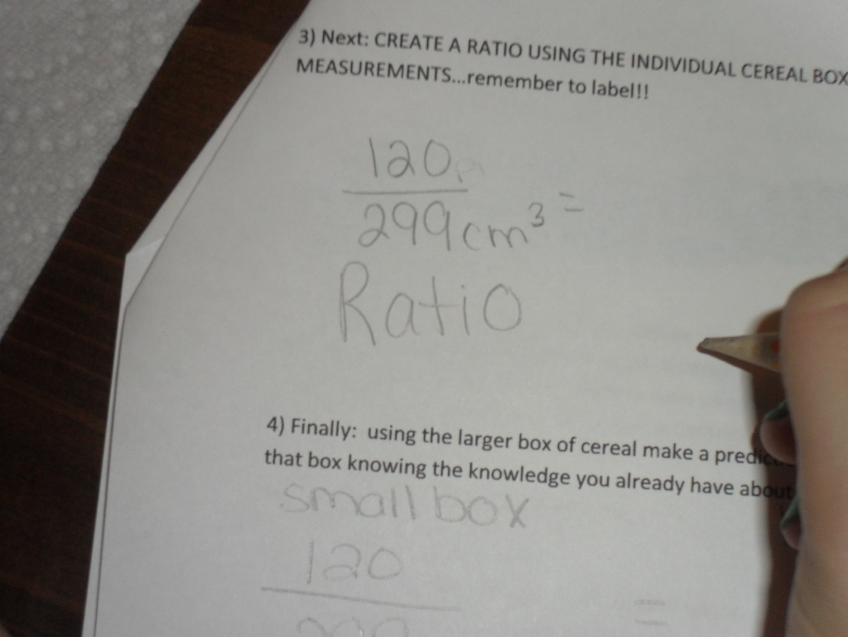
4.Step by step…
In the spaces provided use the numbers found in steps two and three to create a ratio. 120/299 or 120:299

Slide 10
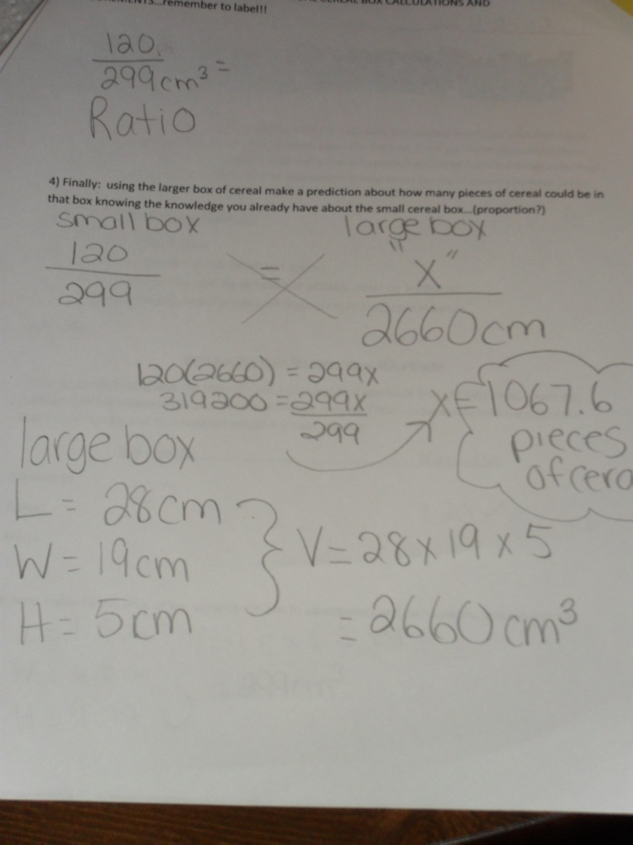
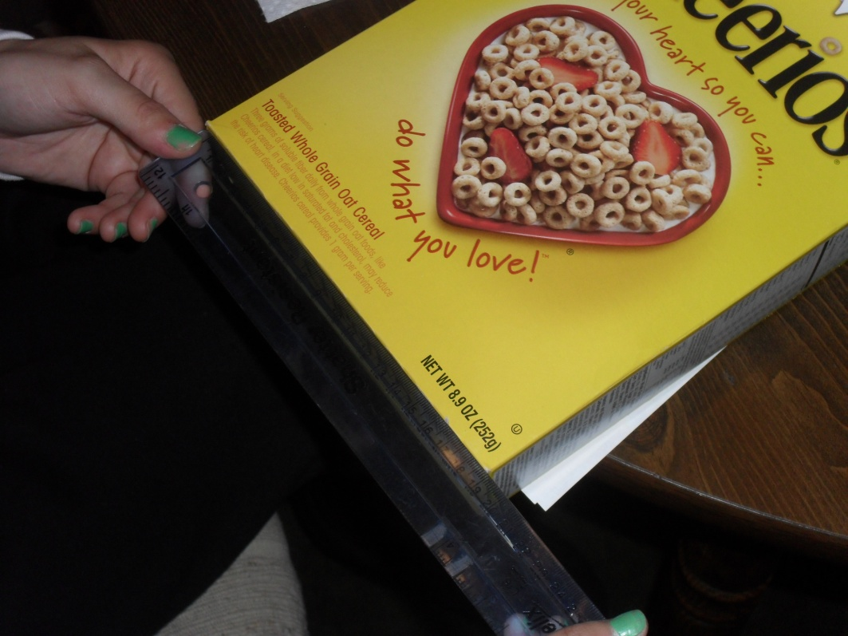
5.Step by step…
Finally: using the larger box of cereal make a prediction about how many pieces of cereal could be in that box knowing the knowledge you already have about the small cereal box…(proportion?)
My brother ate all the Fruit Loops!!

Slide 11
The end!!!
Hand in activity fully completed! Must be neat and organized!
EAT UP!!!

